Slide 1

What is Big Data
Big Data is a collection of data that is huge in volume, yet growing exponentially with time. It is a data with so large size and complexity that none of traditional data management tools can store it or process it efficiently. Big data is also a data but with huge size.

Slide 2



Example of Big Data?
The New York Stock Exchange is an example of Big Data that generates about one terabyte of new trade data per day.
Social Media - The statistic shows that 500+terabytes of new data get ingested into the databases of social media site Facebook, every day. This data is mainly generated in terms of photo and video uploads, message exchanges, putting comments etc.
A single Jet engine can generate 10+terabytes of data in 30 minutes of flight time. With many thousand flights per day, generation of data reaches up to many Petabytes.

Slide 3
Who is generating Big Data ?
Facebook – 10 millions photos/ hour
Google – process 24 PB/day
Twitter – ~400 million tweets/day
WhatsApp – shared 347,222 photos/min
Tinder – 416,667 swipes/min
Pinterest – 3,472 pinned/min
EMAIL – 204 million msg/min

Slide 4
RDBMS and Big Data
Challenge in processing Big Data with RDBMS like Oracle, MySQL, DB2 etc.
• Increase data size force to add more CPU or memory to DBMS
• Data is semi structured or unstructured
• DBMS is designed for data retention not rapid growth(velocity)
• DBMS data allow updating the Data

Slide 5
Types Of Big Data
Following are the types of Big Data:
Structured
Unstructured
Semi-structured
Structured (RDBMS) - OLTP
Any data that can be stored, accessed and processed in the form of fixed format is termed as a ‘structured’ data. Over the period of time, talent in computer science has achieved greater success in developing techniques for working with such kind of data (where the format is well known in advance) and also deriving value out of it. However, nowadays, we are foreseeing issues when a size of such data grows to a huge extent, typical sizes are being in the rage of multiple zettabytes.

Slide 6
Employee_ID | Employee_Name | Gender | Department | Salary_In_lacs
2365 | Rajesh Kulkarni | Male | Finance | 650000
3398 | Pratibha Joshi | Female | Admin | 650000
7465 | Shushil Roy | Male | Admin | 500000
7500 | Shubhojit Das | Male | Finance | 500000
7699 | Priya Sane | Female | Finance | 550000

Slide 7
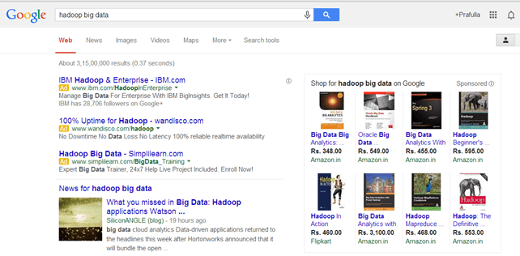
Unstructured
Any data with unknown form or the structure is classified as unstructured data. In addition to the size being huge, un-structured data poses multiple challenges in terms of its processing for deriving value out of it. A typical example of unstructured data is a heterogeneous data source containing a combination of simple text files, images, videos etc. Now day organizations have wealth of data available with them but unfortunately, they don’t know how to derive value out of it since this data is in its raw form or unstructured format.
The output returned
by ‘Google Search’
Web application data, which is unstructured, consists of log files, transaction history files etc.

Slide 8
Semi-structured
Semi-structured data can contain both the forms of data. We can see semi-structured data as a structured in form but it is actually not defined with e.g. a table definition in relational DBMS. Example of semi-structured data is a data represented in an XML file.
Examples Of Semi-structured Data
Personal data stored in an XML file-
<rec><name>Prashant Rao</name><sex>Male</sex><age>35</age></rec>
<rec><name>Seema R.</name><sex>Female</sex><age>41</age></rec>
<rec><name>Satish Mane</name><sex>Male</sex><age>29</age></rec>
<rec><name>Subrato Roy</name><sex>Male</sex><age>26</age></rec>
<rec><name>Jeremiah J.</name><sex>Male</sex><age>35</age></rec>

Slide 9
Characteristics Of Big Data
Big data can be described by the following characteristics:
Volume
Variety
Velocity
Variability
(i) Volume – Refers to the vast amounts of data generated every seconds. We are not talking TB but Zettabytes or Brontobytes. If we take all the data generated in the world between the beginning of time and 2008, the same amount of data will soon be generated every minute. This makes most data sets tool large to store and analyze using traditional database technology
.
(ii) Variety – The next aspect of Big Data is its variety.
Refers to the different types of data we can now use. In the past we only focused on structured data that neatly fitted into tables or relational databases, such as financial data. 80% world data is unstructured (text, images, video, voice etc.). With big data technology we can now analyze and bring together data of different types such as messages, photos, sensor data, video etc.

Slide 10
(iii) Velocity – The term ‘velocity’ refers to the speed of generation of data. How fast the data is generated and processed to meet the demands, determines real potential in the data.
Big Data Velocity deals with the speed at which data flows in from sources like business processes, application logs, networks, and social media sites, sensors, Mobile devices, etc. The flow of data is massive and continuous.
(iv) Value – Having access to big data is not good unless we can turn it into value. Companies are starting to generate amazing value from their big data.

Slide 11
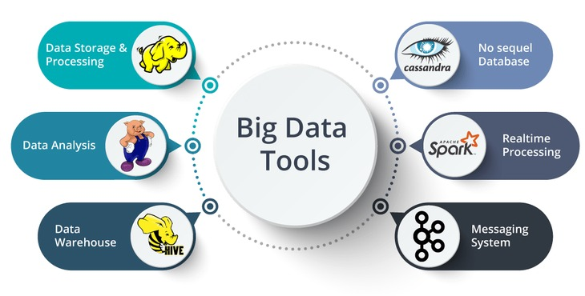
Tools For Dealing BigData

Slide 12
Why Hadoop ?
Data-Intensive processes
Scalability
Storing and Processing large amount of data
Reliability

Slide 13
Various Hadoop Providers
Apache
Cloudera & Hortonworks
Amazon AWS (EMR)
Azure
GCP

Slide 14
HDFS
Hadoop distributed file system-HDFS is the primary storage system of Hadoop.
HDFS stores very large files running on a cluster of commodity hardware.
It works on the principle of storage of less number of large files rather than the huge number of small files.
HDFS stores data reliably even in the case of hardware failure.
It also provides high throughput access to the application by accessing in parallel.

Slide 15
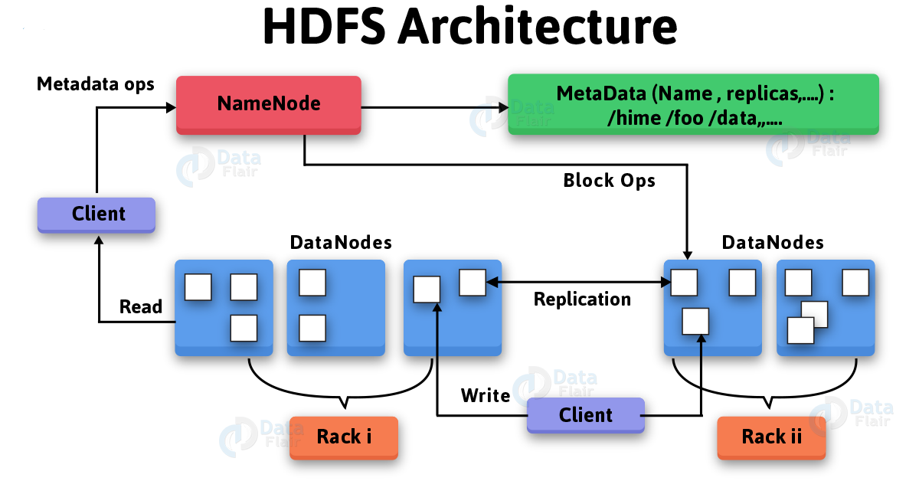

Slide 16
Components of HDFS
NameNode – It works as Master in Hadoop cluster. Namenode stores meta-data i.e.number of blocks, replicas and other details. Meta-data is present in memory in the master to provide faster retrieval of data. NameNode maintains and also manages the slave nodes, and assigns tasks to them. It should deploy on reliable hardware as it is the centerpiece of HDFS.
DataNode – It works as Slave in Hadoop cluster. In Hadoop HDFS, DataNode is responsible for storing actual data in HDFS. It also performs read and writes operation as per request for the clients. DataNodes can deploy on commodity hardware.

Slide 17
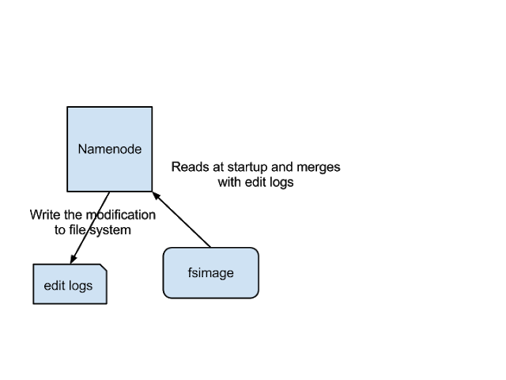
FsImage – FsImage is an “Image file”. It contains the entire filesystem namespace and stored as a file in the namenode’s local file system. It also contains a serialized form of all the directories and file inodes in the filesystem. Each inode is an internal representation of file or directory’s metadata.
EditLogs – EditLogs contains all the recent modifications made to the file system of most recent FsImage. When namenode receives a create/update/delete request from the client. Then this request is first recorded to edits file.

Slide 18
SecondaryNameNode – Secondary NameNode download the FsImage and EditLogs from the NameNode. Then it merges EditLogs with the FsImage periodically. It keeps edits log size within a limit. It stores the modified FsImage into persistent storage. which we can use as FsImage in the case of NameNode failure.

Slide 19
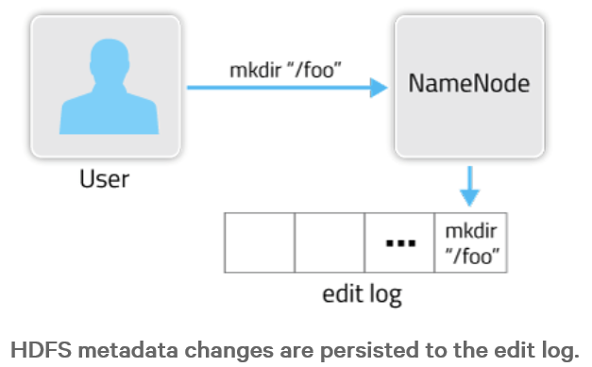
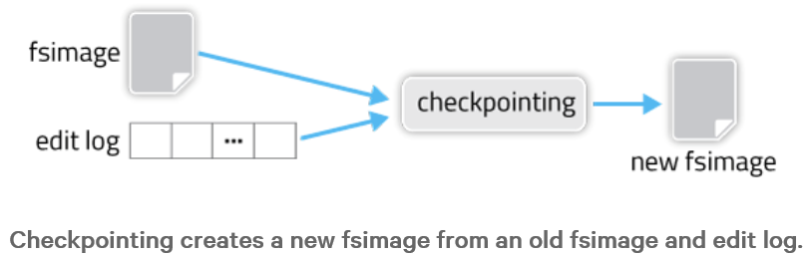

Slide 20
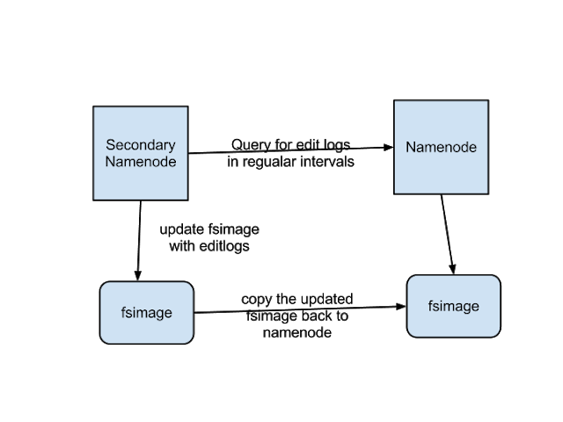

Slide 21
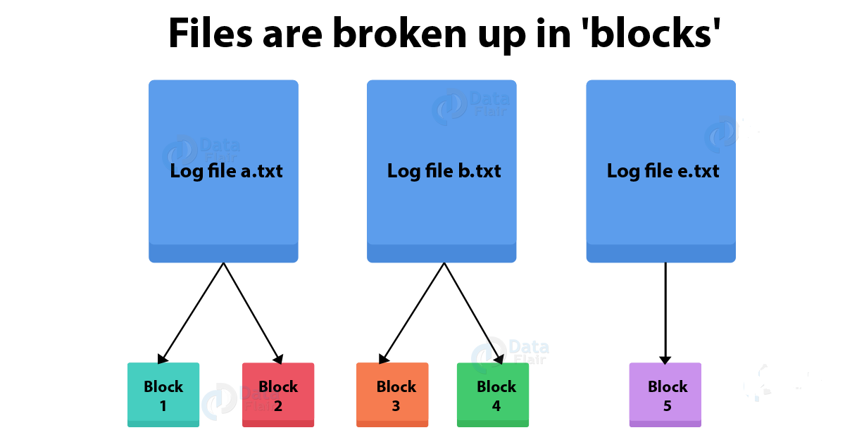

Slide 22
Block in HDFS
Block is a continuous location on the hard drive where data is stored. In general, FileSystem store data as a collection of blocks. In a similar way, HDFS stores each file as blocks, and distributes it across the Hadoop cluster. HDFS client does not have any control on the block like block location. NameNode decides all such things. The default size of the HDFS block is 128 MB, which we can configure as per the requirement. All blocks of the file are of the same size except the last block, which can be the same size or smaller.
Block- It is the physical representation of data.

Slide 23
InputSplit- It is the logical representation of data. Thus, during data processing in MapReduce program or other processing techniques use InputSplit. In MapReduce, important thing is that InputSplit does not contain the input data. Hence, it is just a reference to the data.

Slide 24
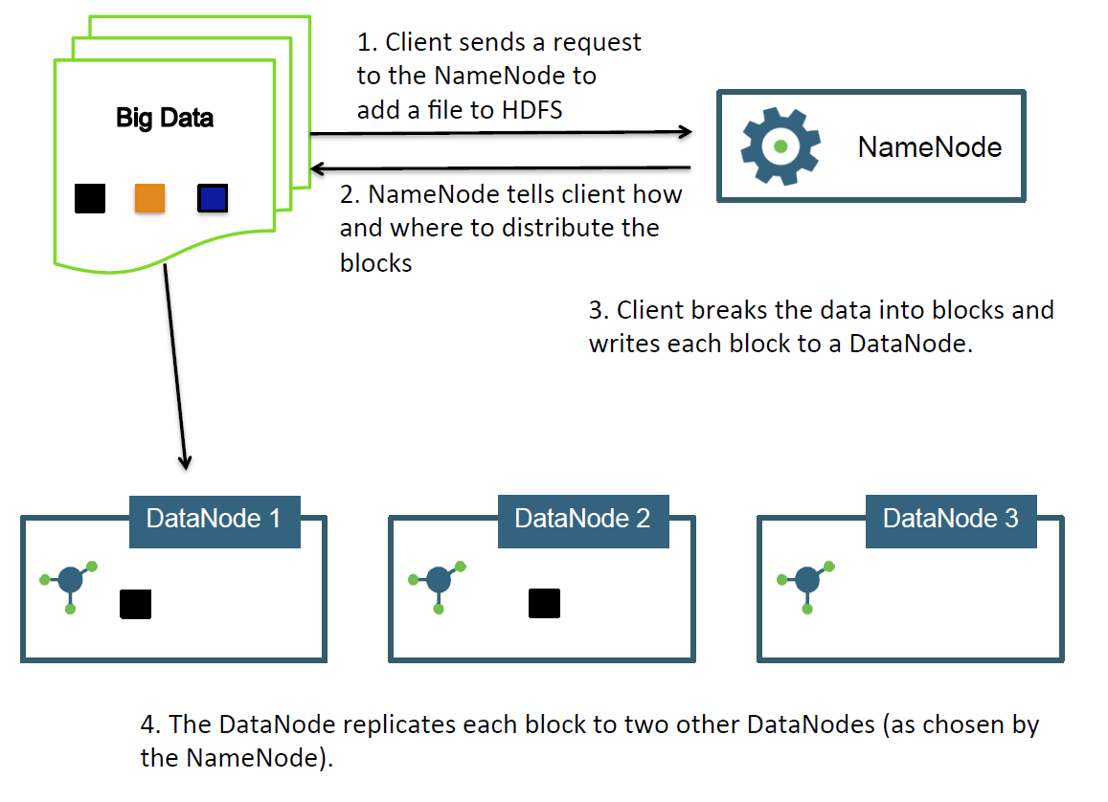

Slide 25
HDFS Commands
Here are a few (of the almost 30) HDFS commands:
-cat: display file content (uncompressed)
-text: just like cat but works on compressed files
-chgrp,-chmod,-chown: changes file permissions
-put,-get,-copyFromLocal,-copyToLocal: copies files from the local file system to the
HDFS and vice versa.
-ls, -ls -R: list files/directories
-mv,-moveFromLocal,-moveToLocal: moves files

Slide 26
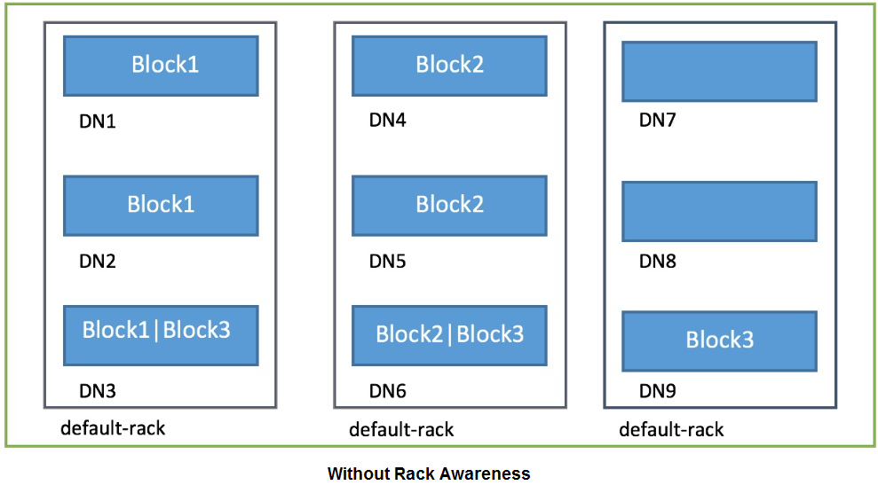
RackAwareness

Slide 27
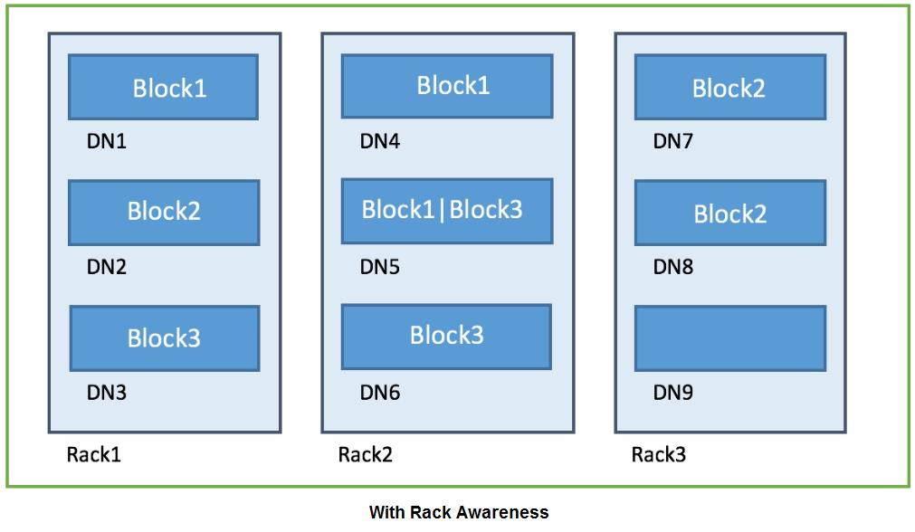

Slide 28
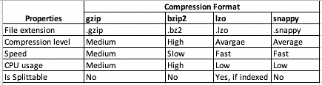
Compression

Slide 29
Features of HDFS (For Interview)
There are several features that make HDFS particularly useful, including:
Data replication. This is used to ensure that the data is always available and prevents data loss. For example, when a node crashes or there is a hardware failure, replicated data can be pulled from elsewhere within a cluster, so processing continues while data is recovered.
Fault tolerance and reliability. HDFS' ability to replicate file blocks and store them across nodes in a large cluster ensures fault tolerance and reliability.
High availability. As mentioned earlier, because of replication across notes, data is available even if the NameNode or a DataNode fails.
Scalability. Because HDFS stores data on various nodes in the cluster, as requirements increase, a cluster can scale to hundreds of nodes.
High throughput. Because HDFS stores data in a distributed manner, the data can be processed in parallel on a cluster of nodes. This, plus data locality (see next bullet), cut the processing time and enable high throughput.

Slide 30
Data locality. With HDFS, computation happens on the DataNodes where the data resides, rather than having the data move to where the computational unit is. By minimizing the distance between the data and the computing process, this approach decreases network congestion and boosts a system's overall throughput.

Slide 31
High Availability(HA)
High Availability - Hadoop 1.x
NameNode and JobTracker was single point of failure in Hadoop 1.x.
Secondary NameNode helps to prevent the data loss.
Secondary NameNode can’t act as Primary NameNode in case of failure.
Manual failover is require in case of Hadoop 1.x
A downtown is require to bring back the Hadoop cluster to running state.

Slide 32
High Availability – Hadoop 2.x
HA introduced in Hadoop 2.x
HDFS HA is implemented by making NameNode highly available.
YARN HA is implemented by making Resource Manager highly available.

Slide 33
HDFS HA
HDFS HA is implemented by running two NameNode in active/standby mode.
Active NameNode serves all Read/Write requests from client.
Standby/Passive NameNode keeps all metadata sync with Active NameNode.
Standby NameNode automatically becomes active in case of Active NameNode failure.
HDFS HA Implementation in two way
Using Quorum Journal Nodes
Using Shared Storage Spaces like NFS

Slide 34
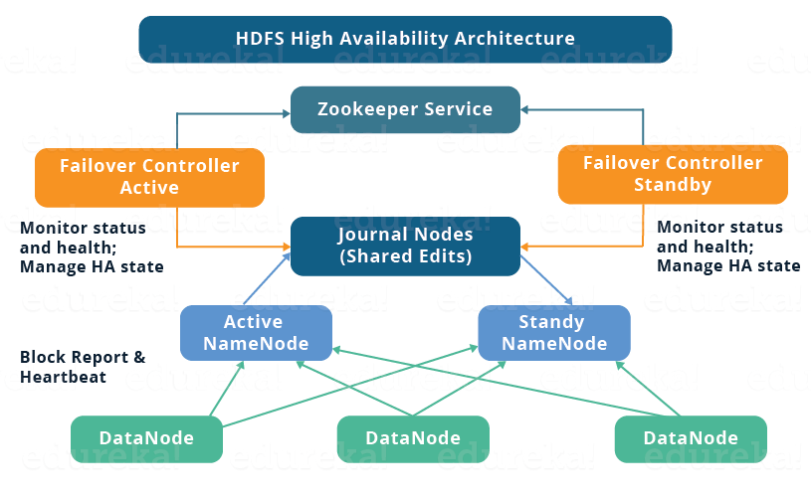
HDFS HA Architecture
ZooKeeper is a distributed co-ordination service to manage large set of host.

Slide 35
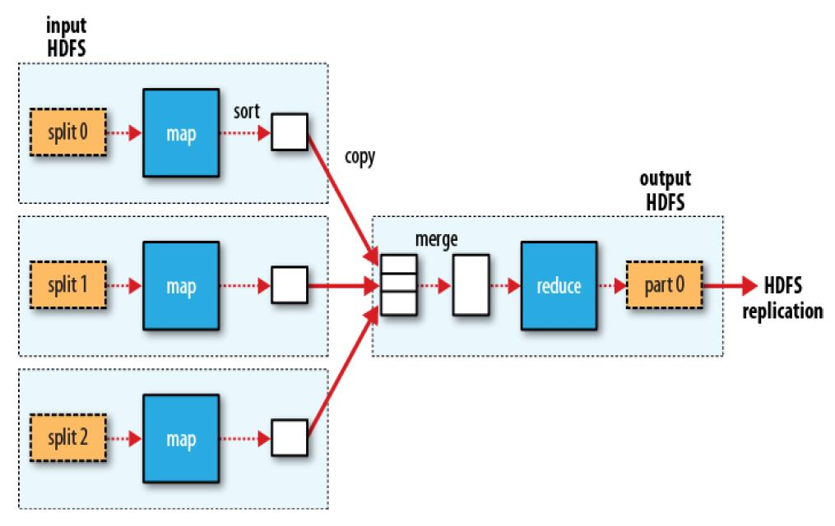
MapReduce
Map Phase
Shuffle, Sort
Reduce Phase

Slide 36
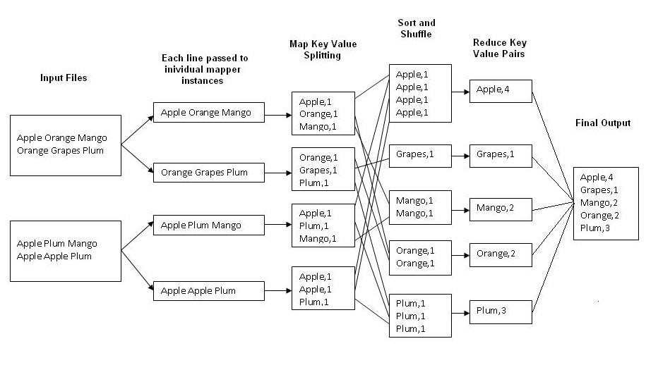
MapReduce – Wordcount

Slide 37
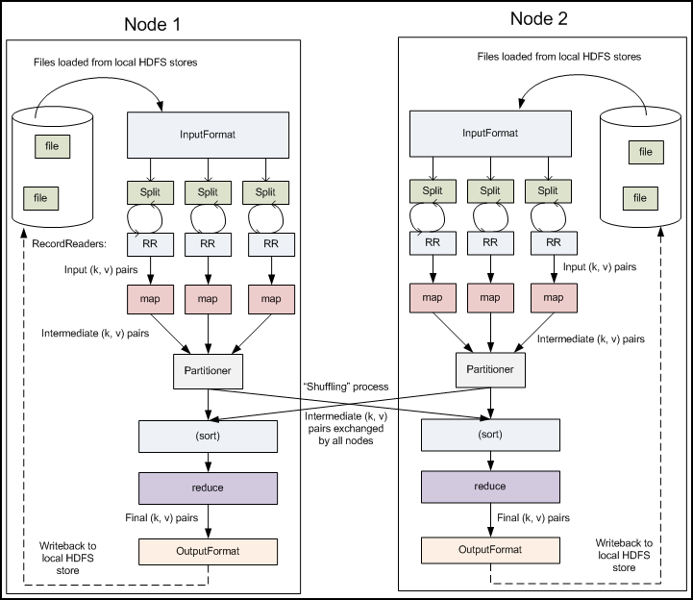
Partitioner

Slide 38
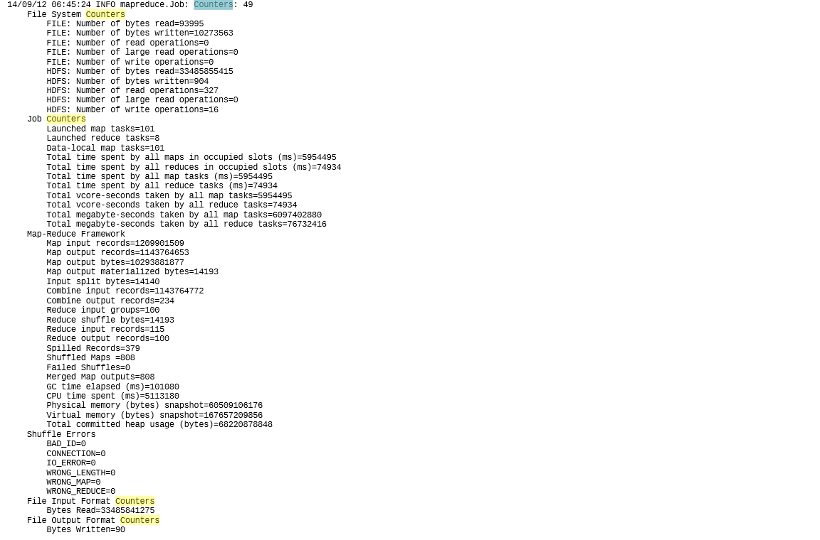
Counters

Slide 39
Distributed Cache
DistributedCache is a facility provided by the MapReduce framework to cache files (text, archives, jars etc.) needed by application
Application which needs to use distributed cache to distribute a file should make sure that the file is available and can be accessed via urls. Urls can be either hdfs:// or http://
Now once the file is present on the mentioned url and user mention it to be a cache file to the distributed cache API, the Map-Reduce framework will copy the necessary files on all the nodes before initiation of the tasks on those nodes.

Slide 40
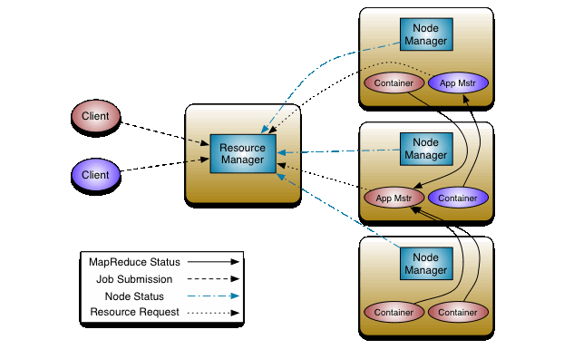
YARN

Slide 41
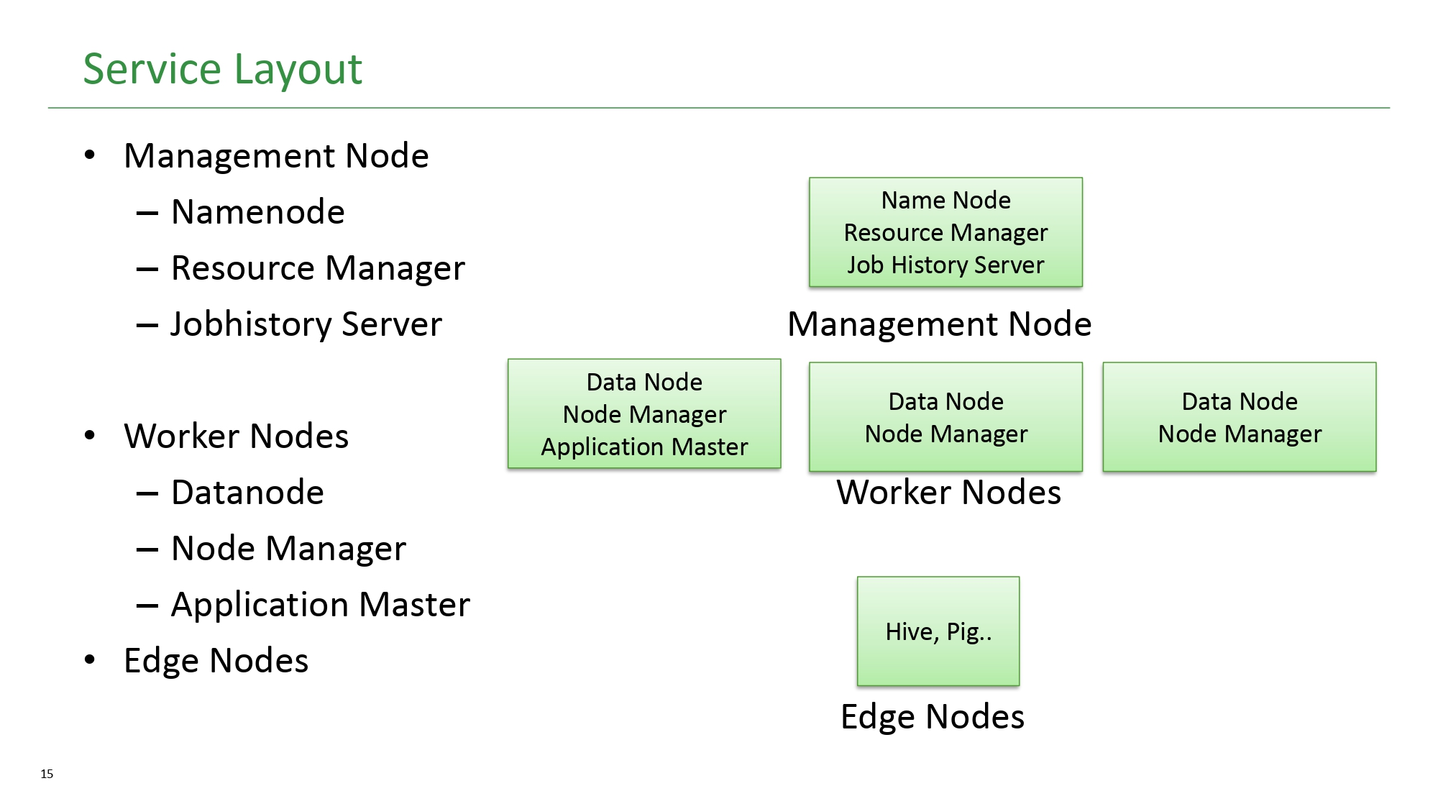
YARN Components

Slide 42
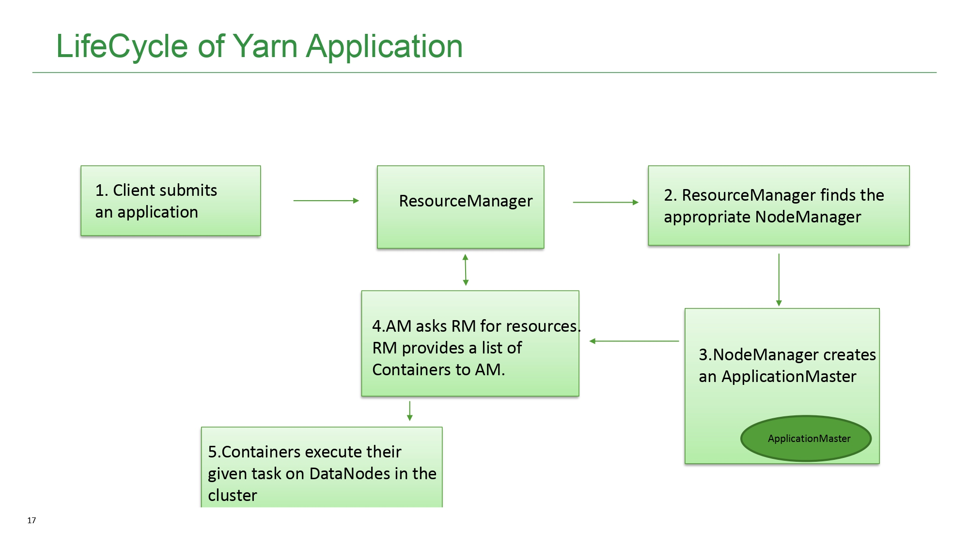

Slide 43
ResourceManager (RM) : is the master that arbitrates all the available cluster resources and thus helps manage the distributed applications running on the YARN system. It works together with the per-node NodeManagers (NMs) and the per-application ApplicationMasters (AMs). Default port : 8088.
The ResourceManager has two main components: Scheduler and ApplicationsManager.
The Scheduler is responsible for allocating resources to the various running applications subject to familiar constraints of capacities, queues etc. The Scheduler is pure scheduler in the sense that it performs no monitoring or tracking of status for the application. Also, it offers no guarantees about restarting failed tasks either due to application failure or hardware failures. The Scheduler performs its scheduling function based on the resource requirements of the applications; it does so based on the abstract notion of a resource Container which incorporates elements such as memory, cpu, disk, network etc.
The Scheduler has a pluggable policy which is responsible for partitioning the cluster resources among the various queues, applications etc. The current schedulers such as the CapacityScheduler and the FairScheduler would be some examples of plug-ins.
The ApplicationsManager is responsible for accepting job-submissions, negotiating the first container for executing the application specific ApplicationMaster and provides the service for restarting the ApplicationMaster container on failure. The per-application ApplicationMaster has the responsibility of negotiating appropriate resource containers from the Scheduler, tracking their status and monitoring for progress.

Slide 44
JobHistoryserver : JobTracker or ResourceManager keeps all job information in memory. For finished jobs, it drops them to avoid running out of memory. Tracking of these past jobs are delegated to JobHistory server. Default jobhistoryserver port is 19888.
NodeManager : is responsible for launching and managing containers on a node. Containers execute tasks as specified by the AppMaster. Default Port : 8042
Application Master (AM) : is the process that coordinates the execution of an application in the cluster. Each application has its own unique Application Master that is tasked with negotiating resources (Containers) from the Resource Manager and working with the Node Managers to execute and monitor the tasks.
Edge Node : is a computer that acts as an end user portal for communication with other nodes in cluster computing. Edge nodes are also sometimes called gateway nodes or edge communication nodes. In a Hadoop cluster, three types of nodes exist: master, worker and edge nodes.

Slide 45
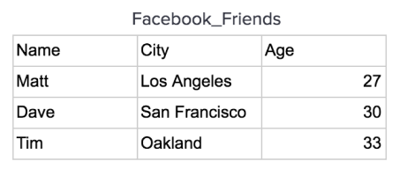
Columnar storage Vs Row storage
Row Oriented Databases
Traditional Database Management Systems were created to store data. They are optimized to read and write a single row of data which lead to a series of design choices including having a row store architecture. In a row store, or row oriented database, the data is stored row by row, such that the first column of a row will be next to the last column of the previous row.
For instance, let’s take this Facebook_Friends data:

Slide 46
This data would be stored on a disk in a row oriented database in order row by row like this:
This allows the database write a row quickly because, all that needs to be done to write to it is to tack on another row to the end of the data.

Slide 47
Column Oriented Databases
Data Warehouses were created in order to support analyzing data. These types of databases are read optimized. In a C-Store, columnar, or Column-oriented database, the data is stored such that each row of a column will be next to other rows from that same column.
Let’s look at the same data set again and see how it would be stored in a column oriented database.

Slide 48
A table is stored one column at a time in order row by row:

Slide 49
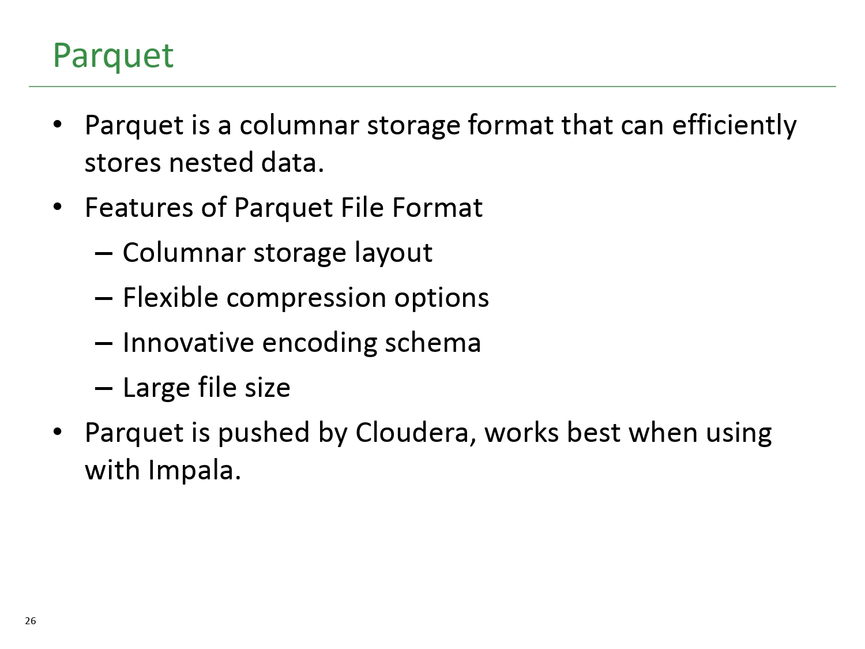

Slide 50
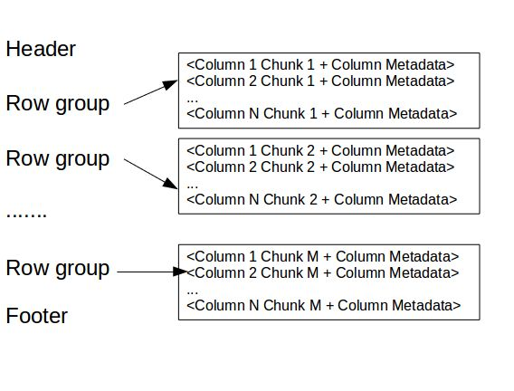

Slide 51
Row group​​ : A logical horizontal partitioning of the data into rows. A row group consists
of a column chunk for each column in the dataset.
Column chunk​​ : A chunk of the data for a particular column. These column chunks live
in a particular row group and is guaranteed to be contiguous in the file.
Page​​ : Column chunks are divided up into pages written back to back. The pages share a
common header and readers can skip over page they are not interested in.

Slide 52
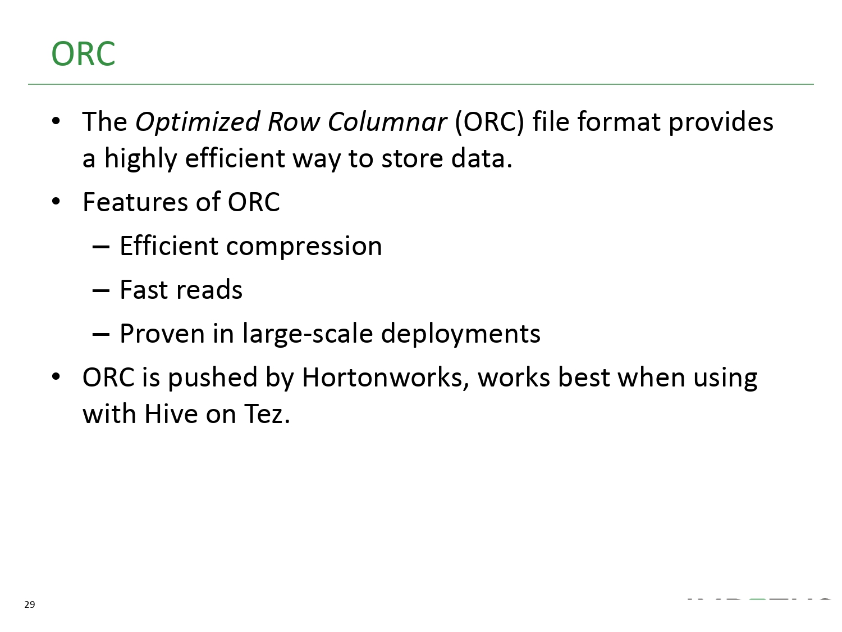

Slide 53
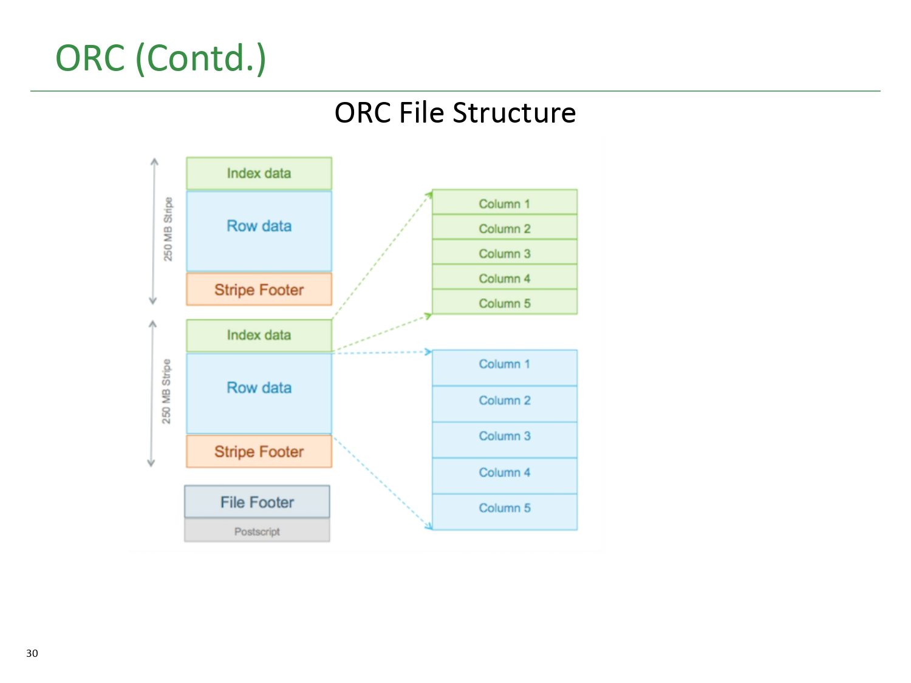

Slide 54
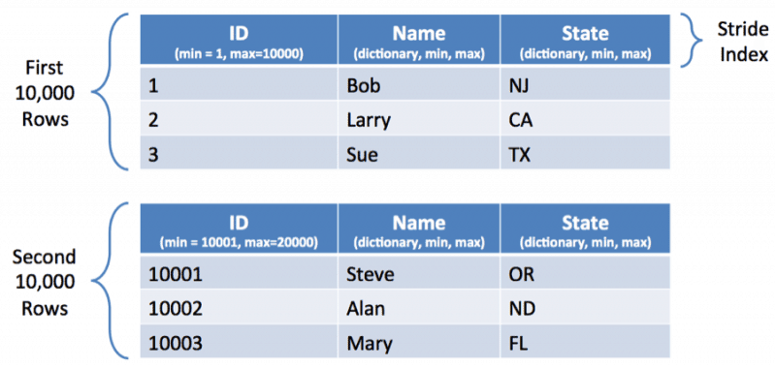

Slide 55
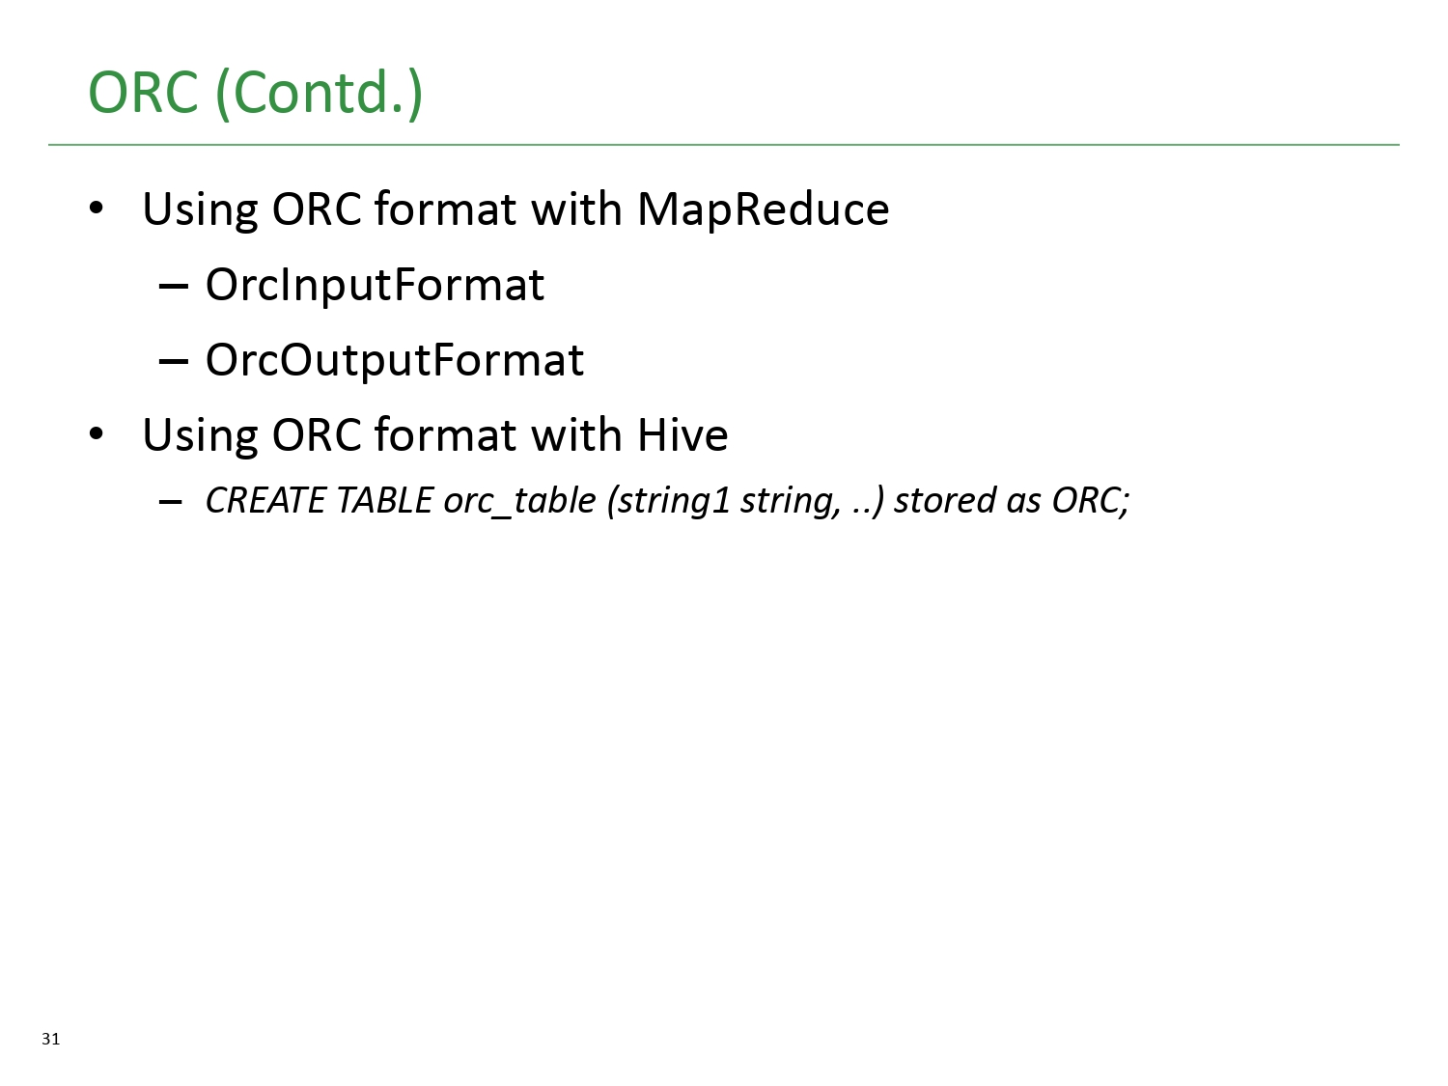

Slide 56
Commands useful for hadoop engineer
1. Create recursive directories on hadoop:-
hadoop fs -mkdir -p /training/hadoop
2. Upload data file on hdfs
hadoop fs -put empdata.txt /training/hadoop
3. List hadoop directory files
hadoop fs -ls /training/hadoop
4. Download file from hdfs to local file system
hadoop fs -get /training/hadoop/empdata.txt
5. Display hadoop file content on terminal
hadoop fs -cat /training/hadoop/empdata.txt

Slide 57
Docker SetUp
Get the hadoop setup
docker pull imrankhan1/takeo-de
Start container from docker desktop
bash
su imran
imran

